Slide 1
Humanize Your District
Council of Great City Schools – Public Relations Executives

Slide 2
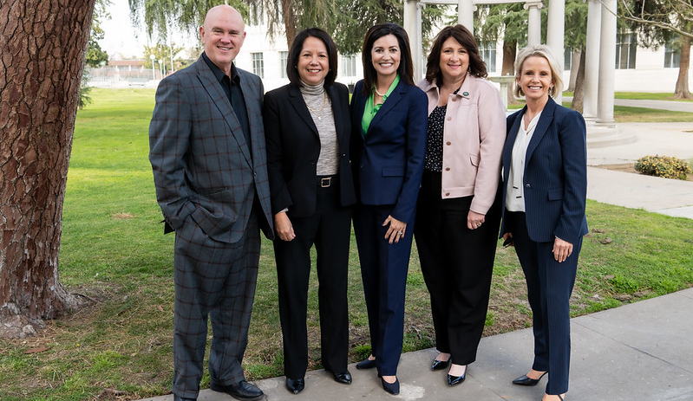
Learning Outcomes:
Learn why it is SO important to put faces and names to every one of your communications – and HOW to do it!
Gather strategies and ideas to put into action immediately to start humanizing your district
Improve your consistency without losing precious time
Grow your media relationships simply and quickly
How to develop advisory committees to deepen your understanding of your audiences
Notes:
Superintendents

Slide 3

Fresno Unified’s Current Reality & Results
Incredibly high-need district
Only 1 in 3 students meeting or exceeding in ELA, only 1 in 5 for math
Historically negative narrative of underperforming district
And yet, a statistically significant and representative survey of our parents in June/July of 2022 showed:
More than 8 in 10 parents and 3 in 4 staff members are satisfied with communication from Fresno Unified (more than 1 in 3 parents and 2 in 5 staff members are VERY satisfied!)
About 3 out of 4 parents and staff view Fresno Unified’s communications as TRUSTWORTHY, understandable, accurate, and timely

Slide 4
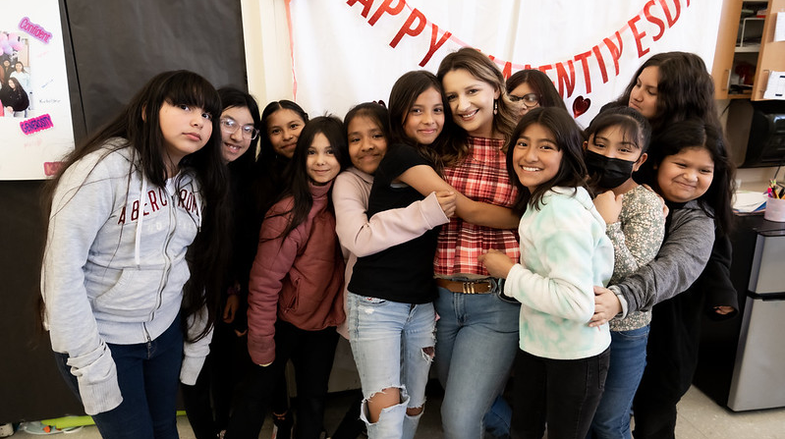
Why Should I “Humanize” My District?
Engagement thrives on human relationships and relationships build from knowledge, familiarity, and trust
Student, family, and employee engagement all contribute to improved outcomes
Familiarity with leaders, teachers, and communications staff provides calm in a storm
Without your voice, negativity will fill the void
Media partners will be more likely to include a district perspective in stories
Gives your students, families, staff, and community an opportunity to be ambassadors for your district
Notes:
Girl power club at Kirk Elementary

Slide 5

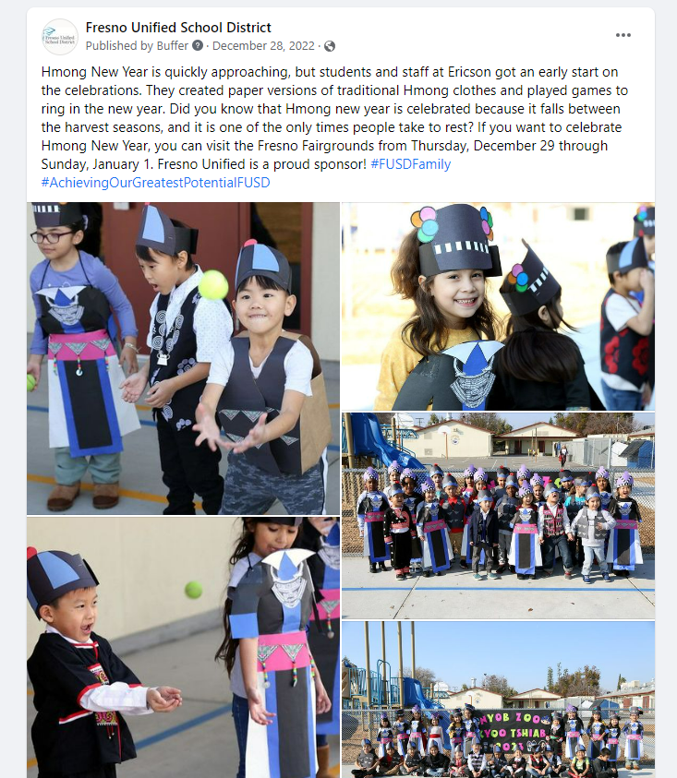
How Fresno Unified is “Humanizing” Our District
Daily Social Media Highlights
Every single school and department gets a chance throughout the year to be highlighted
You provide the ask, they provide the content
Students, families, staff, and community get to see sites and people they know personally – increases engagement
Tips & Tricks:
Keep all videos less than 60 seconds for better social media engagement
Give examples to site/department leaders to get ideas
Write your own captions and tie back to your district goals
Link to video
Share through ParentSquare!

Slide 6
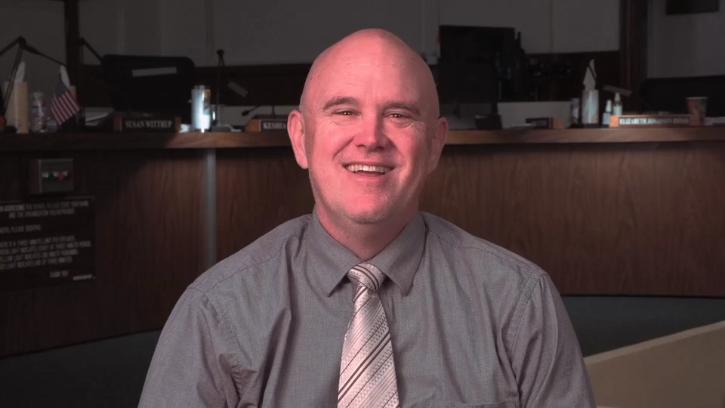
How Fresno Unified is “Humanizing” Our District
Share through ParentSquare!
Weekly Superintendent/Deputy Superintendent Messages
Every 1-2 weeks with a message directly from Bob or Misty
Allows audiences to see and hear the personalities of our leaders on a regular basis
Allows us to highlight key messages that might not be seen or heard otherwise
Tips & Tricks:
Include important information, especially if it’s tough information
Include celebrations and recognitions
Point back to other content to encourage further engagement
Link to video

Slide 7



How Fresno Unified is “Humanizing” Our District
Share through ParentSquare!
Faces of Fresno Unified magazine
Repurposing and streamlining several series of content
Authentic, deep storytelling that brings to life the work of the district
Multiple uses for evergreen content
Advertising fund generation
Moving digital vs. huge printing and mailing costs for district newspaper
Tips & Tricks:
Ask staff to nominate others for features to increase engagement
Use the nominees and awardees from your “educator of the year” programs

Slide 8
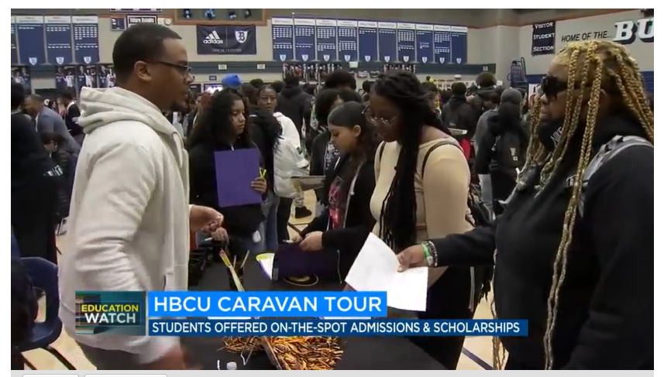
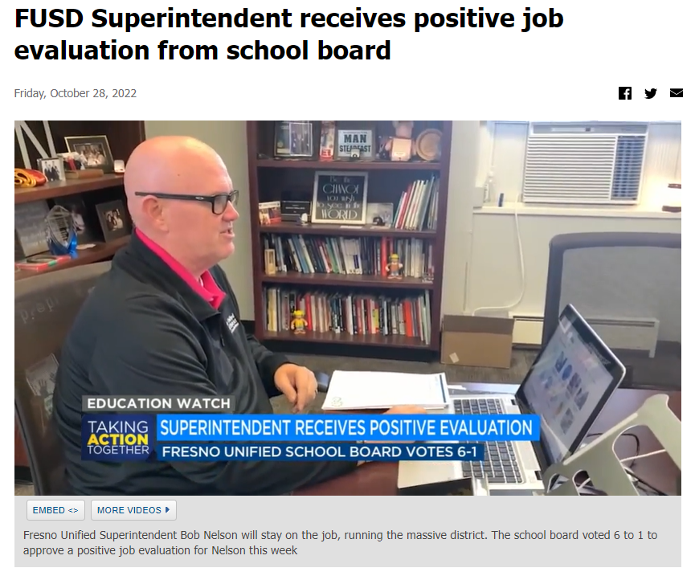
How Fresno Unified is “Humanizing” Our District
Consistent Media Relations
Regularly pitching and providing positive stories
Providing interviews as often as we possibly can
Offering exclusives on tough subjects for balanced stories
Tips & Tricks:
Prioritize and provide exclusives for media outlets where your audiences watch/listen/read the most
Share their positive stories on your social media to “reward” with your followers

Slide 9

How Fresno Unified is “Humanizing” Our District
Audience Advisory Groups
Developed 3 advisory groups:
Student
Parent
Principal
Gather feedback on communications plans, hot topics, improving services
Student advisory includes time with Superintendent, learning opportunities with staff, and a culminating group project
Tips & Tricks:
Ensure the majority of your meetings are focused on their input to you – not the other way around
Work with Principals and VPs to recruit students
Link to video
Use Groups in ParentSquare!

Slide 10
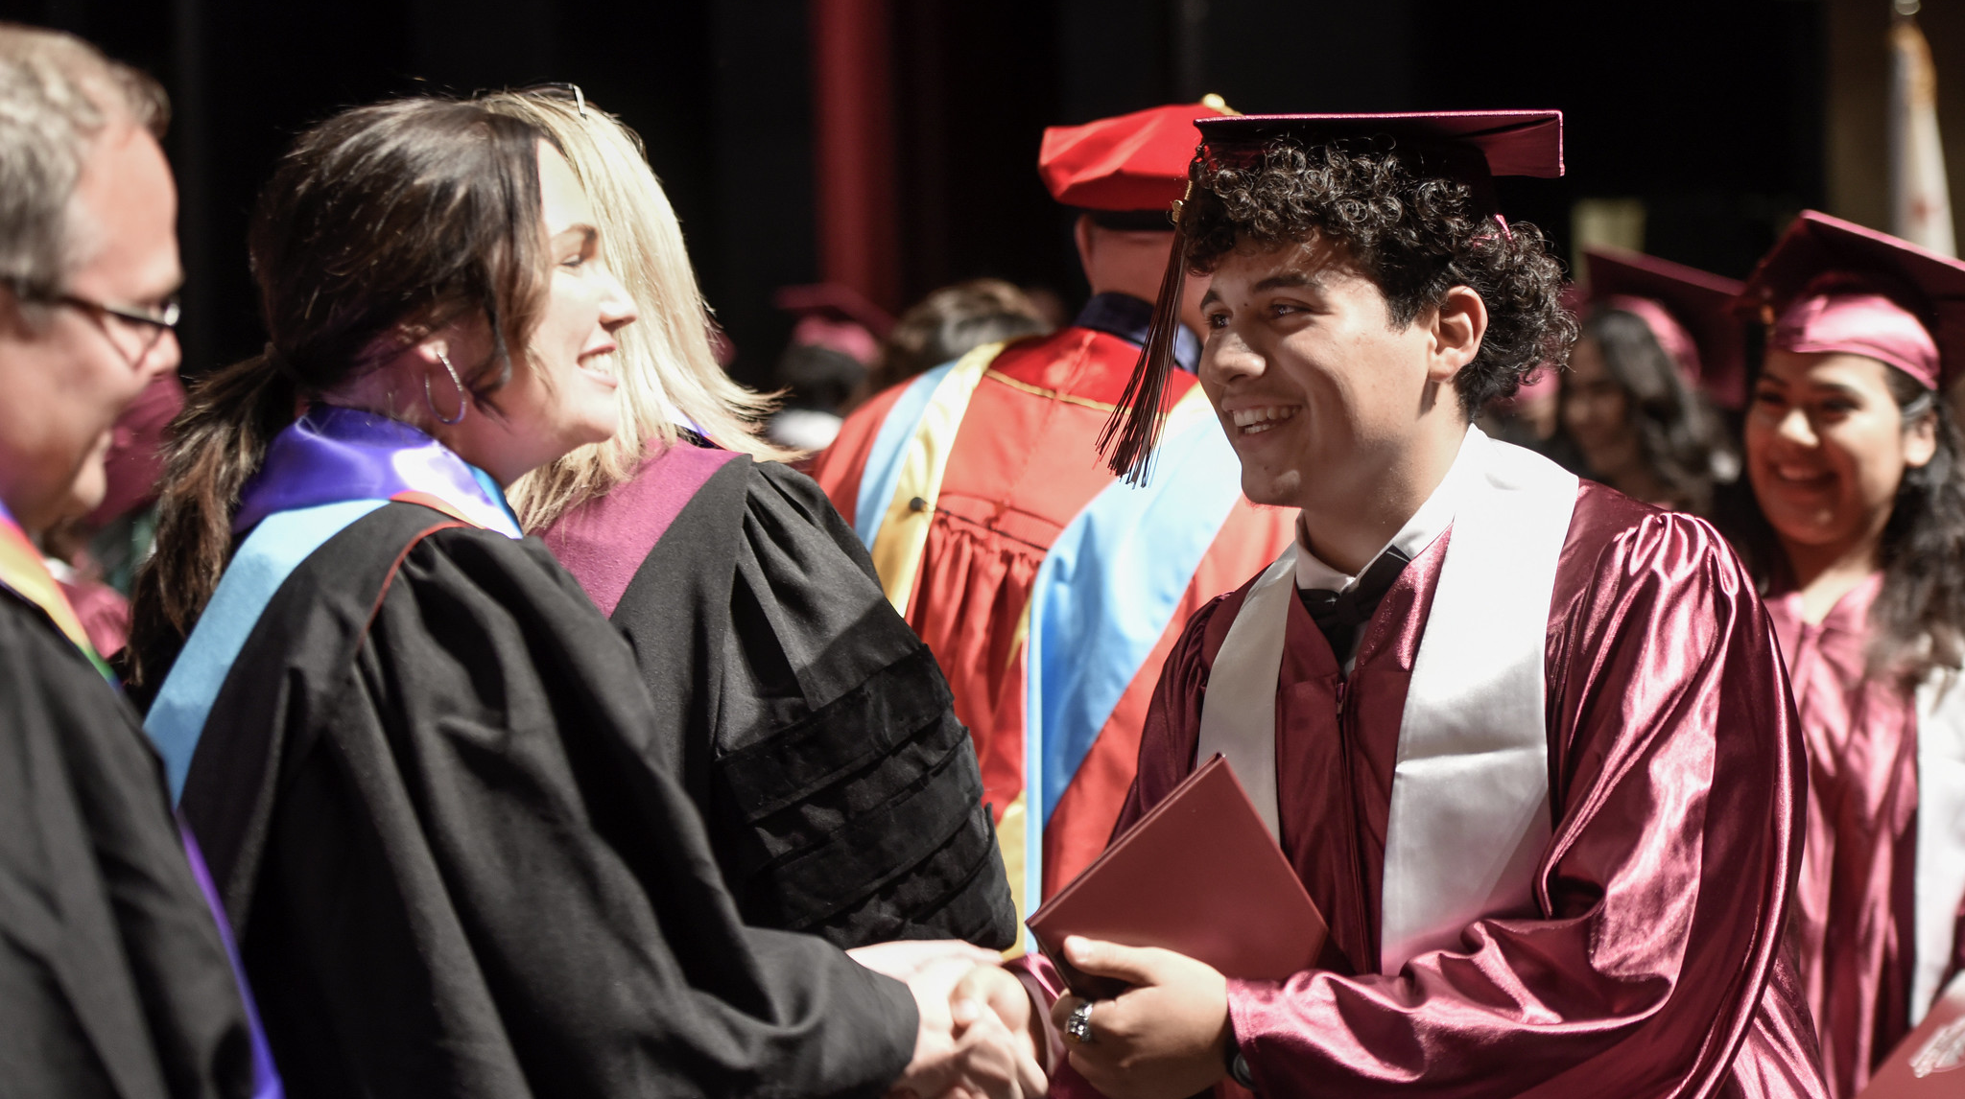
Things You Can Start NOW!
Bring a face and name to EVERY one of your communications – especially through ParentSquare!
Don’t be afraid to be out there! Especially Superintendents, Assistant Superintendents, Cabinet Members, and Communications staff
Consistency is key – everything doesn’t have to be elaborate
BE WITH YOUR AUDIENCES
Be authentically you and lead by example

Slide 11

Brainstorming Exercise
Notes:
Take 3 minutes to write down as many HUMAN story ideas you can think of – don’t think of HOW you tell the story, just what the story might be
Get people up and find someone you don’t know
Pair share for 3-5 minutes on how to tell the stories with the resources at your fingertips

Slide 12
ParentSquare - Before & After
Spring Climate and Culture Survey
More than DOUBLED parent/family participation year over year
Summer Camps Enrollment
30% increase in unique student enrollments
135% increase in foster/homeless youth enrollments
109% increase in students receiving specialized services enrollments
94% increase in EL student enrollments
23% increase in African American student enrollments
Scholarship Applications
114% increase in completed scholarship applications year over year

Slide 13

Questions?
Notes:
Take 3 minutes to write down as many HUMAN story ideas you can think of – don’t think of HOW you tell the story, just what the story might be
Get people up and find someone you don’t know
Pair share for 3-5 minutes on how to tell the stories with the resources at your fingertips

Slide 14


Impacting student outcomes by
moving districts from
Mass Communication to Mass Engagement
Equity, Engagement, Oversight
Notes:
Before I begin
As schools understand the importance of engaging parents, each person and department is doing their own thing, Districts use one technology, sites use another, and classrooms yet another.
Most of this technology is trying to get parents informed

Slide 15

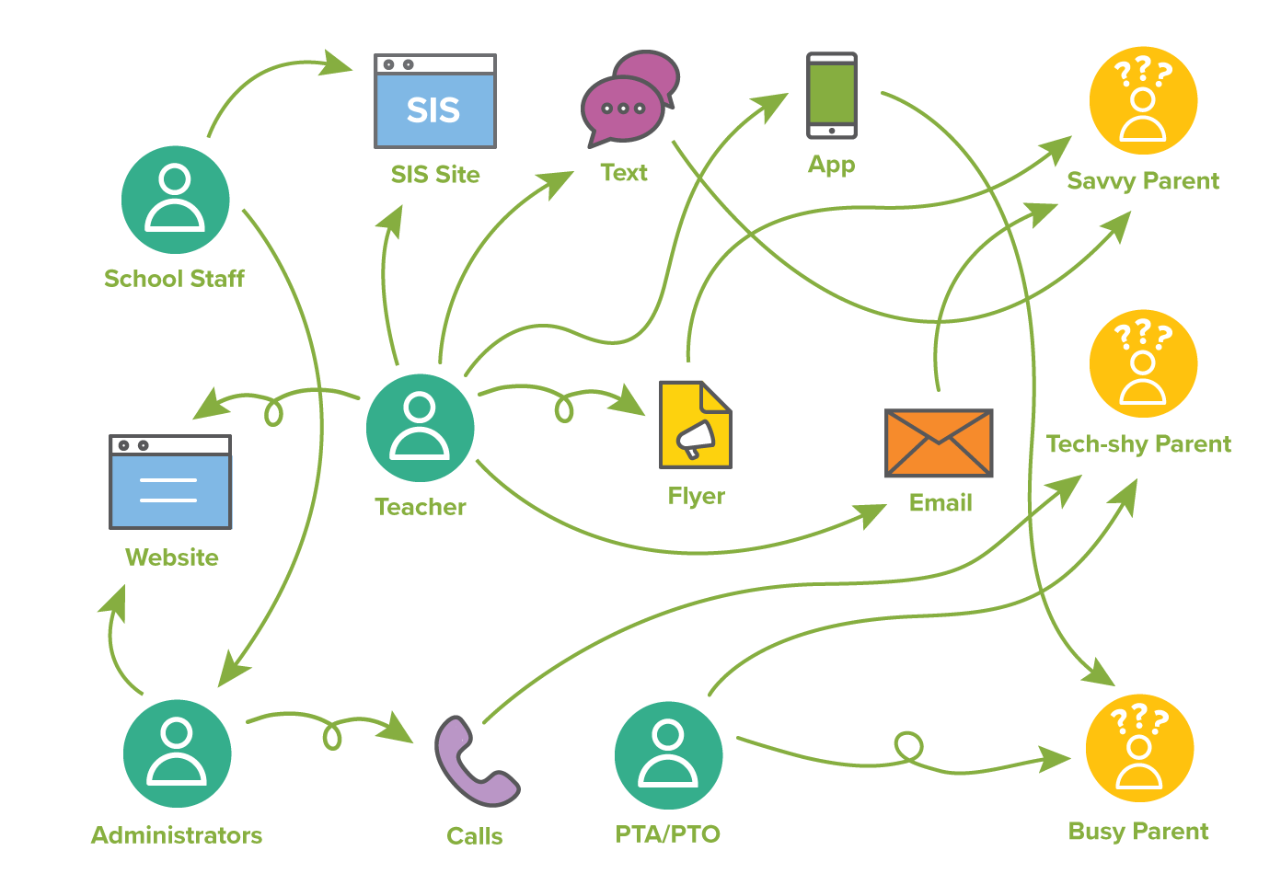
The Challenge
Notes:
Before I begin
As schools understand the importance of engaging parents, each person and department is doing their own thing, Districts use one technology, sites use another, and classrooms yet another.
Most of this technology is trying to get parents informed

Slide 16
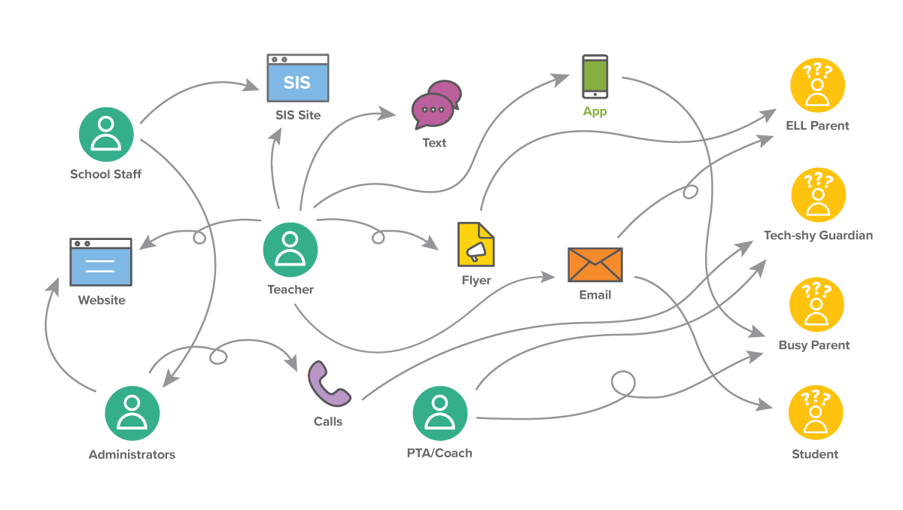

The Challenge
Alerts & Notifications
Classroom
Language Translation
Extracurriculars
Internal
Community
Web
Notes:
Before I begin
As schools understand the importance of engaging parents, each person and department is doing their own thing, Districts use one technology, sites use another, and classrooms yet another.
Most of this technology is trying to get parents informed

Slide 17
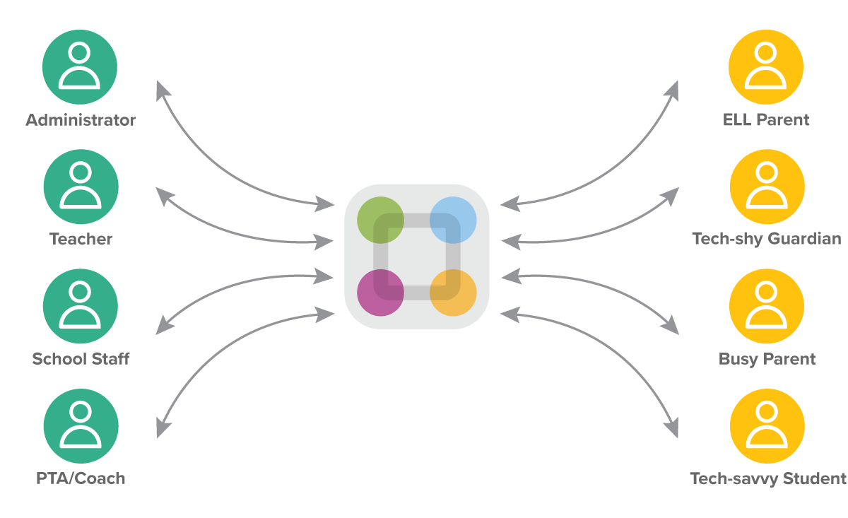
The Opportunity
All Your school interactions in Single, Secure Location
Notes:
Before I begin
As schools understand the importance of engaging parents, each person and department is doing their own thing, Districts use one technology, sites use another, and classrooms yet another.
Most of this technology is trying to get parents informed

Slide 18
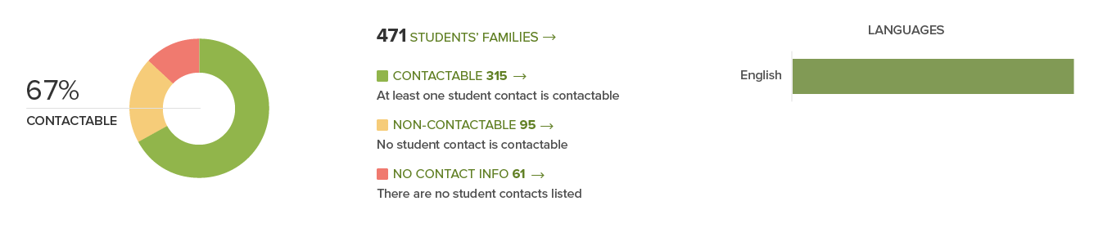
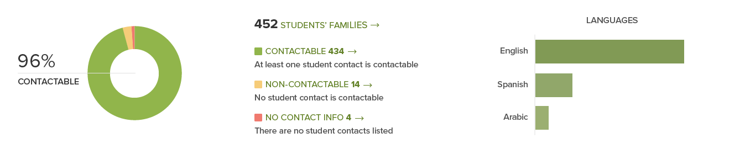
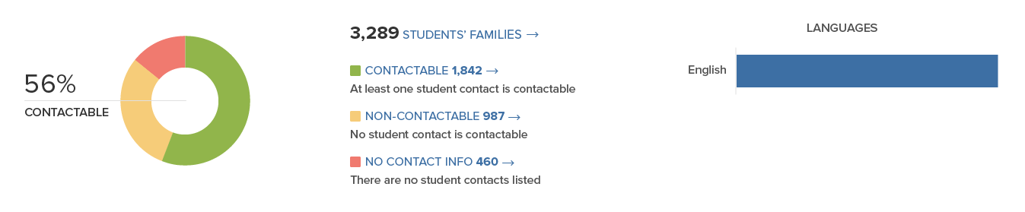
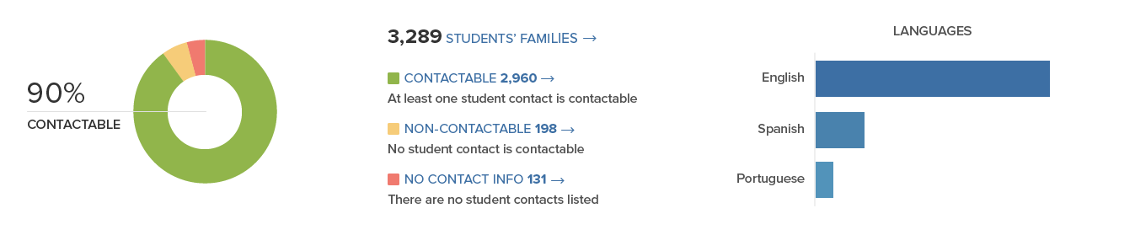
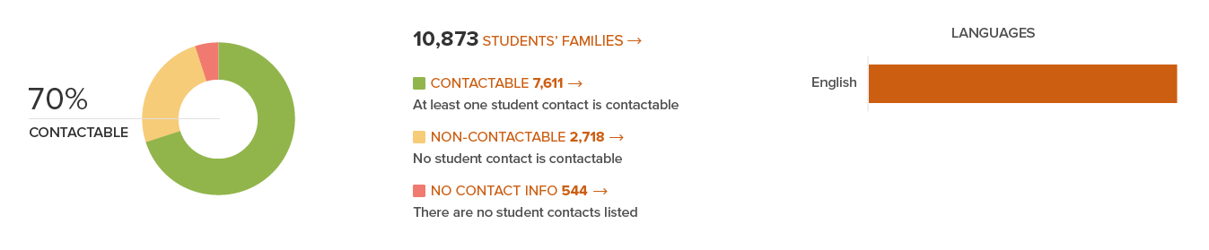
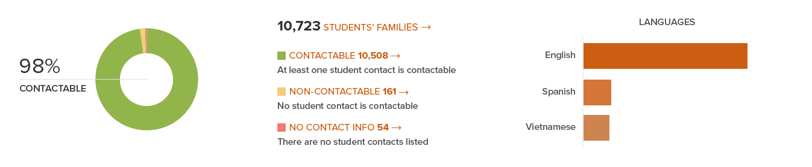
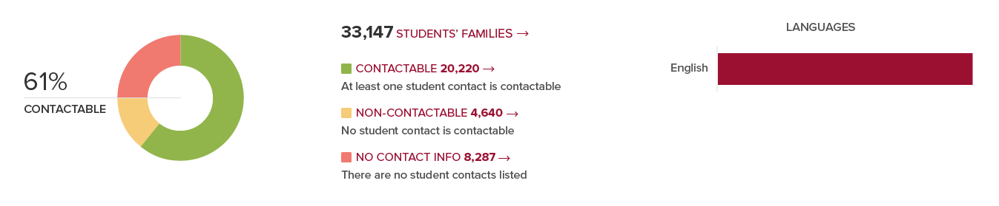
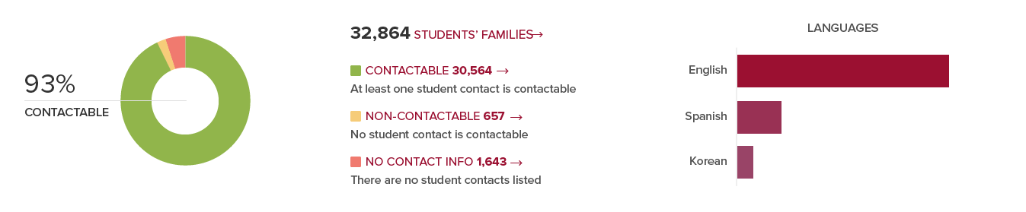
Measure & Improve Contactability
Initial Data Sync
One Year Improvement

Slide 19







Remove Modality Barriers
Text
Email
Push Notifications
Voice Calls
Social/Website
iOS App
Android App

Slide 20




How is ParentSquare Different?
Mass Notifications
Classroom Communications
School Services
Website CMS
Maximize engagement, ensure consistency
Empower teachers, increase reach
Embed forms and services to increase response rates
Engage your community and make your brand stand out
One Unified Platform
Save time, gain oversight, streamline support, engage everyone.

Slide 21

Thank You!

